Slide 1
Frontend for end-users
Jeroen Claassens
Notes:
Good morning everyone. In the workshop today I will introduce you to the world of frontend development.

Slide 2
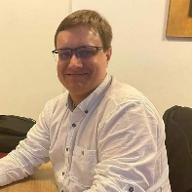
Who am I
Jeroen Claassens | Experienced Software Engineer +31 (0)6 5112 7382
j.claassens@cgi.com
Notes:
First a bit about myself. Hi! My name is Jeroen Claassens. I’ve been a developer for about 10 years now

Slide 3
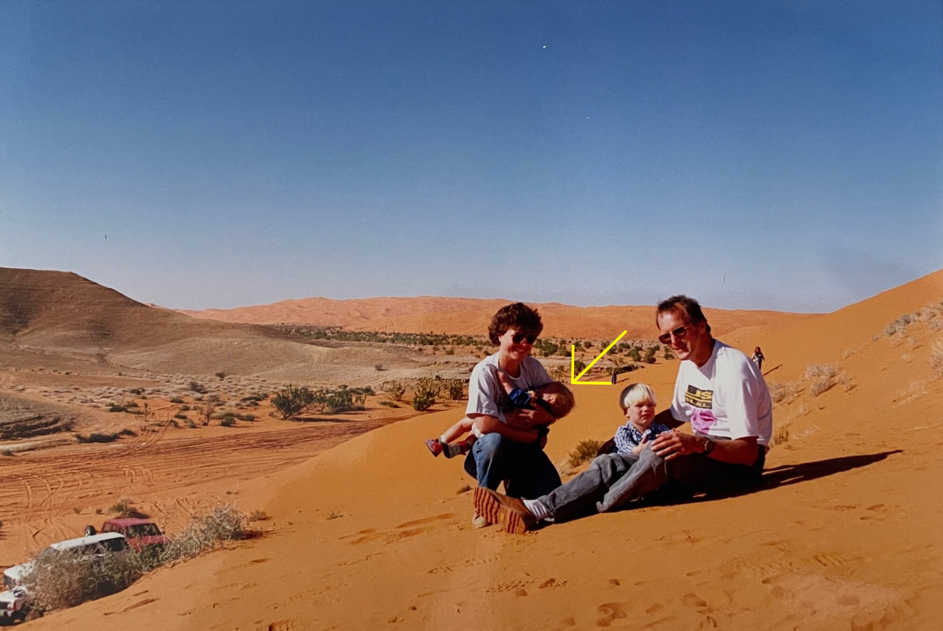
Who am I?
I Live in Delft
I’m a huge fantasy nerd (talk to me about Lord of The Rings, Harry Potter, Dungeons & Dragons, and more)
I do a lot of open source development in my free time.
I love building PCs and working with tech.
Notes:
I was born in the deserts of Saudi Arabia

Slide 4
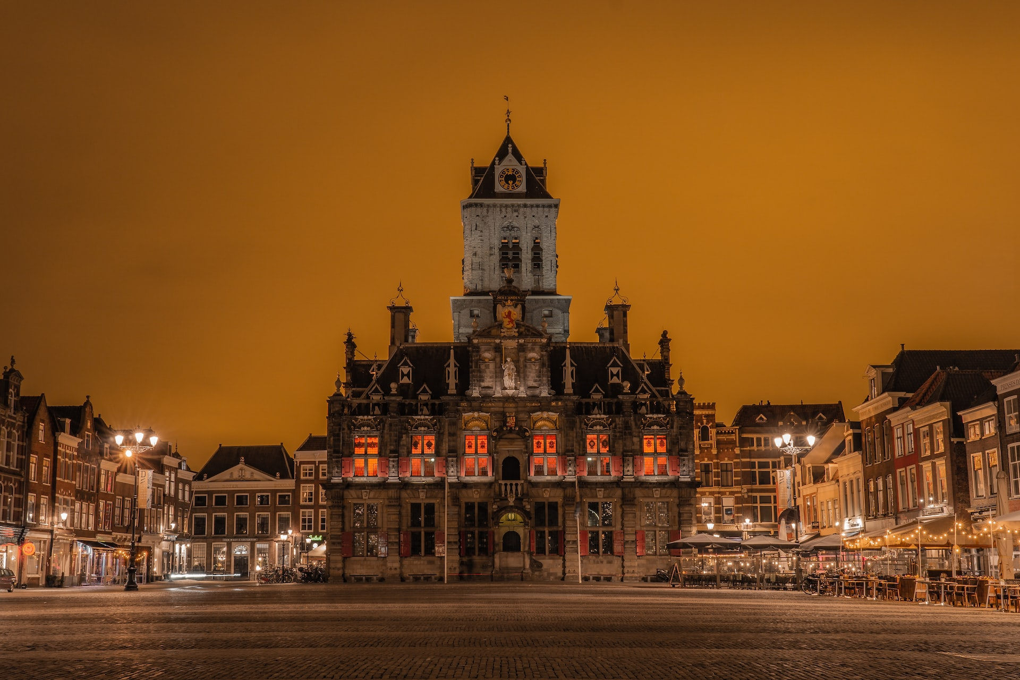
Who am I?
I Live in Delft
I’m a huge fantasy nerd (talk to me about Lord of The Rings, Harry Potter, Dungeons & Dragons, and more)
I do a lot of open source development in my free time.
I love building PCs and working with tech.
Notes:
but right now I live in the beautiful city of Delft

Slide 5
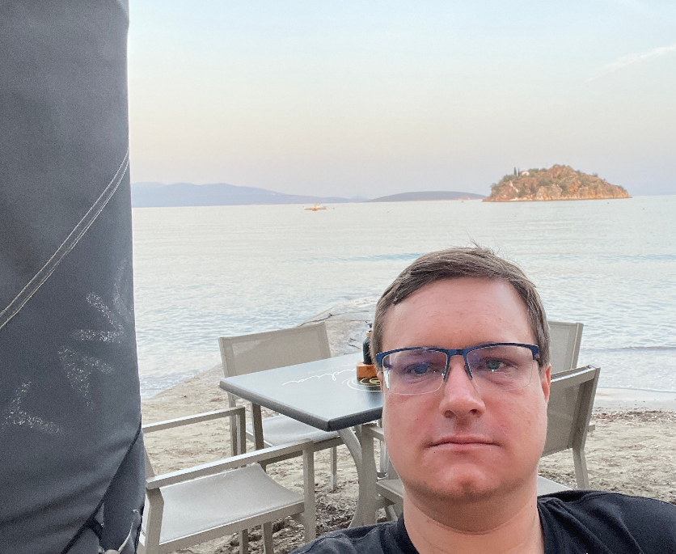

Who am I?
I’m a huge fantasy nerd (talk to me about Lord of The Rings, Harry Potter, Dungeons & Dragons, and more)
My free time is primarily spent with open source development and (table-top) gaming.
I love learning about and working with all tech.
Notes:
In my spare time I’m a huge lover of all kinds of fantasy. My free time I primarily spent workin on various open source projects that I maintain and I also game a lot. In general I am also a big fan of all things tech.

Slide 6


Who am I?
Jeroen Claassens (Experienced Software Engineer)
Started at CGI in March 2019
Rijkswaterstaat (1,5 years)
Full-stack TypeScript & Java developer
Primarily worked the new Asset Management frontend
ProRail (2,5 years)
Full-stack TypeScript & Java developer
Worked on improving the front- and backend of the GMS/WLIS project
Back at Rijkswaterstaat (current)
Java developer & ops engineer
Back on the project of 2019, of which the landscape has greatly changed
Notes:
I started working for CGI in 2019. First I worked for the Rijkswaterstaat unit where I was primarily a frontend development but also dabbled a bit in the Backend, CI/CD, Cloud and Ops processes of the project. After this I moved to the ProRail unit where I worked as a full-stack frontend and backend developer, and right now I have moved back to Rijkswaterstaat and I am now working on the same project where I started at 2019 but primarily as a backend developer while also doing ops.

Slide 7
General workshop information
The workshop will have both and morning and afternoon program
I encourage the taking of notes, because we will go through a lot of information
These slides will be sent to all participants after the course. The slide notes have a rough outline of what I have told you.
Notes:
First I would like to address some general notes for today. Today we will have both a morning and an afternoon program. Furthermore this is the first time that we are including a frontend fundamentals workshop in the graduate class, so in advance I’m apologize for any mistakes haha. Because of this I can also not say entirely for sure at what time we will be finished, but at the latest we will stop at 4 30.
Next I encourage the taking of notes. We will go through a lot of information and there will be a lot of information to process. Notes can help you do so.
Lastly these slides will be sent to all participants after the course. I have included the bulk of what I will tell you in the speaker notes of each slide so you can review most of the workshops.

Slide 8
Has everyone managed to install NodeJS?
Notes:
Before we start I would like to check if everyone was able to complete their homework, installing NodeJS.
For those that have faced issued, I have reserved a about 10 minutes before the lunch to aid you.

Slide 9
Agenda
A brief introduction to frontend and its importance
HTML / CSS / JavaScript
Lunch 🥪🍽️
Frontend development in the field
Notes:
Now lets go over the agenda for today. To start I will give you a brief introduction to what frontend is, how we define frontend for the scope of this workshop, and why frontend should be considered as an important part of the services delivered by CGI. After this I will give you an introduction to HTML, CSS, and JavaScript which together make up the fundamental building blocks for developing a modern frontend. This should take until about a quarter to twelve after which there will be some time to help anyone who wasn’t able to complete their homework or time for longer questions and then we’ll have lunch until 1 o clock. After the lunch we’ll dive into the frontend development as you might see it being used in the field at CGI projects, this means we’ll start working with Node, looking into libraries like React, and more.

Slide 10
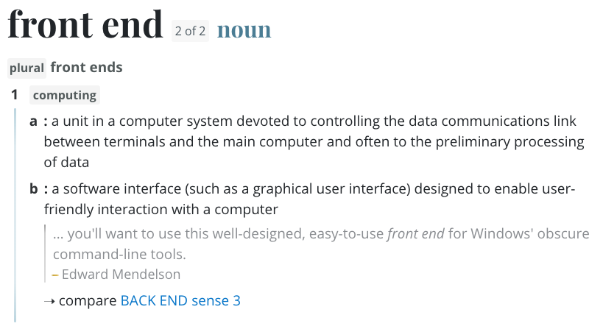
What does “frontend” even mean!?
Notes:
Lets stay by defining the term “frontend”. I like to think that it’s often best to start with a definition from the dictionary. The dictionary defines the frontend as a software interface, such as a graphical user interface, designed to enable user-friendly interaction with a computer. What this means is that for an end-user to use a program, they will always use a frontend of some kind. That frontend can be a program such as Microsoft Word or Notepad, or a website such as Google.

Slide 11
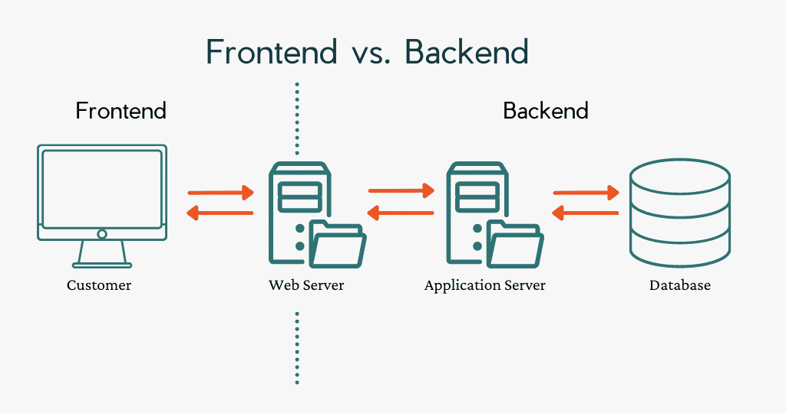
What does “frontend” even mean!?
Notes:
The opposite of a frontend is the backend, which is everything the user does not interact with. Frontend and backend are always coupled in some way, such as through a server.
So as you can probably surmise, frontends are very important because without a frontend the end-user has nothing to interact with. That said, it should also be noted that not with every project at CGI you will be doing frontend development, this will really vary per project. Some projects already have a frontend and you’re only updating or maintaining a backend, some projects are purely only scripts that are manually run by users, and some are none of these options. That said, it will always be good to have a fundemental knowledge.

Slide 12
What is the scope for today?
Notes:
So the concept of frontend is very wide, but we will only focus on a small part of it for today, and that’s the web frontend part.

Slide 13
What is frontend development?
Notes:
Frontend development involves crafting the parts of a website that users see and interact with directly. It's about turning code into the appealing visuals and intuitive interfaces we all enjoy.

